Slide 1
Building and Operating modern .NET Core applications as microservices in containers
Damir Dobric
daenet CEO, Lead Architect
Microsoft Regional Director
Azure Most Valuable Professional
https://damirdobric.me

Slide 2
Agenda
Evolution of compute platform
Docker Containers
Running .NET Core in docker
Azure Container Registry
Azure Container Instances
Orchestrators
K8 (Kubernetes)
Service Fabric
…

Slide 3
Evolution
VMs
Containers
Orchestrators
PaaS
Serverless

Slide 4
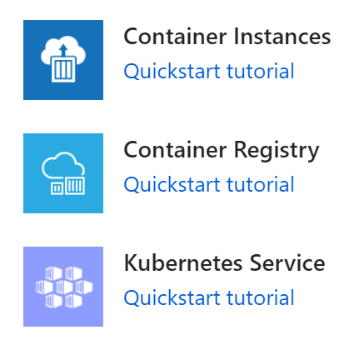
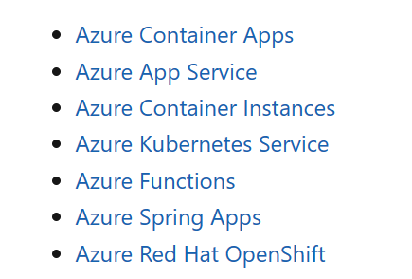
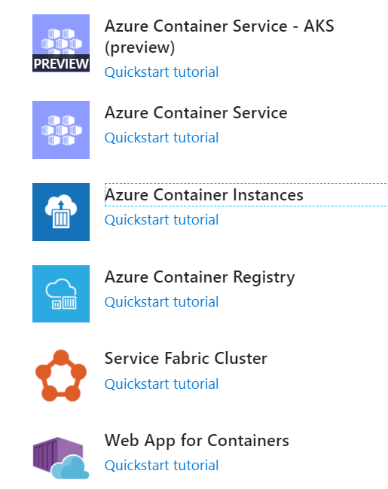
Containers in Azure
Comparing Container Apps with other Azure container options

Slide 5
VM
Virtualization of everything running on OS

Slide 6
Container | MOBI | Docker
Virtualization of a single application
https://www.youtube.com/watch?v=vmnvOITMoIg

Slide 7
Docker Containers
VMs
Containers
Orchestrators
PaaS
Serverless

Slide 8
Running .NET Core in Docker container
https://developers.de/2019/04/17/fastest-way-to-build-net-core-app-docker-image/

Slide 9
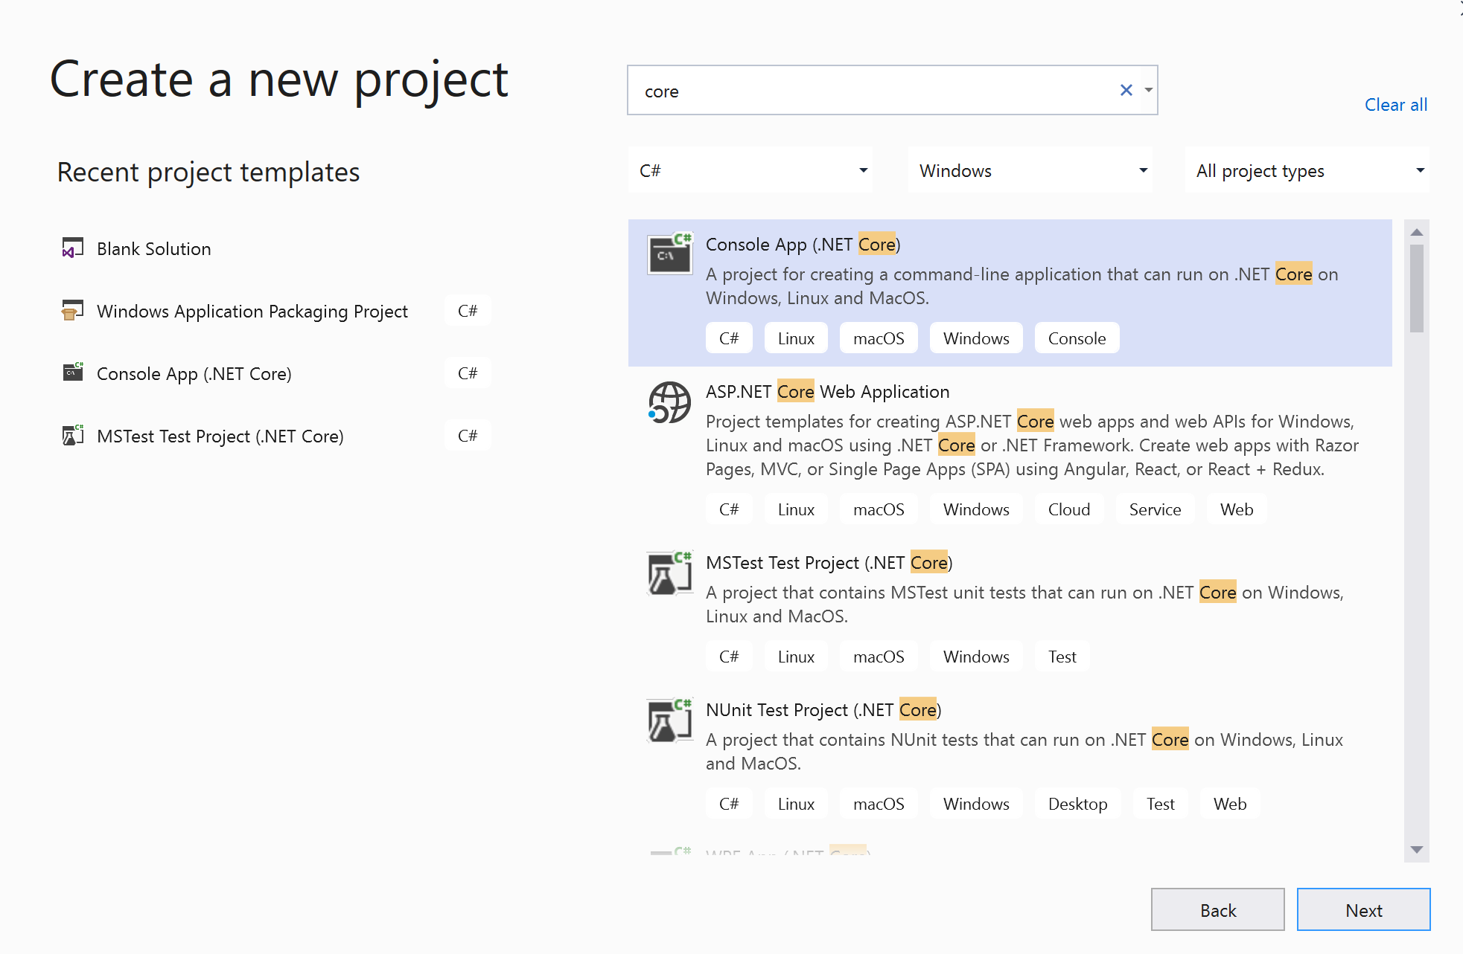

Slide 10
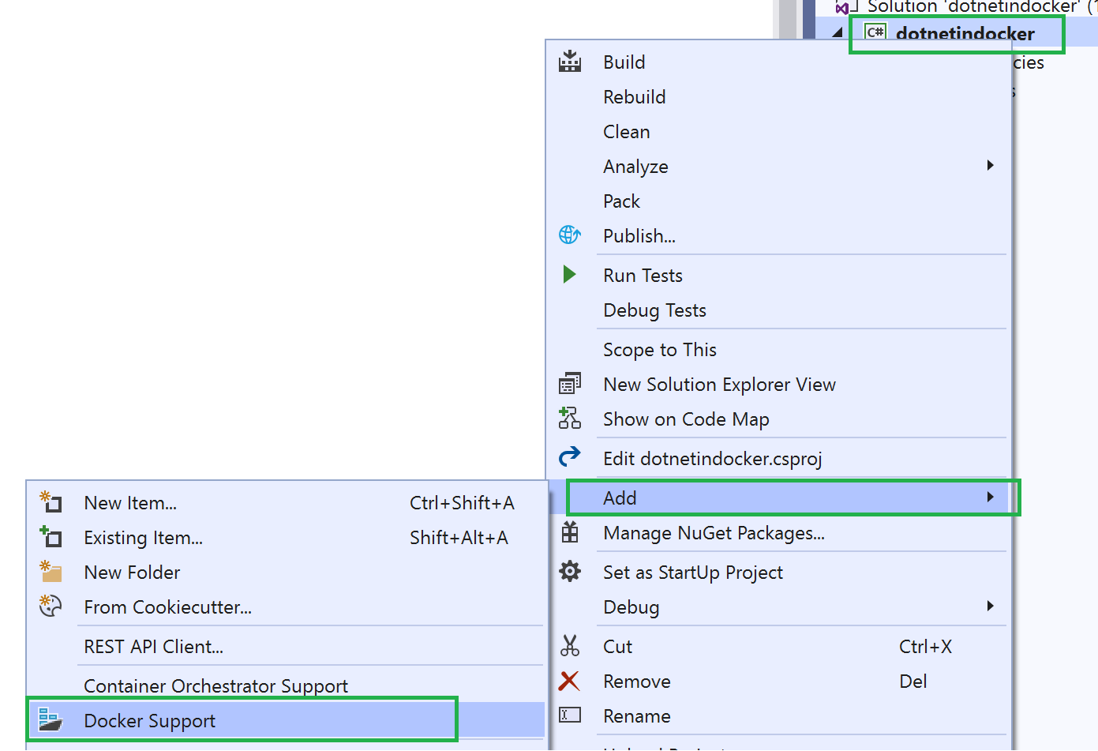
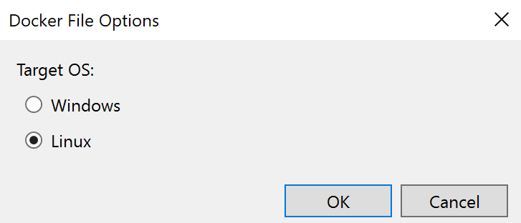
Create .NET App in container (I)
static void Main(string[] args)
{
int n = 100;
while (--n > 0)
{
Console.WriteLine("Hello World!");
Thread.Sleep(1000);
}
}

Slide 11
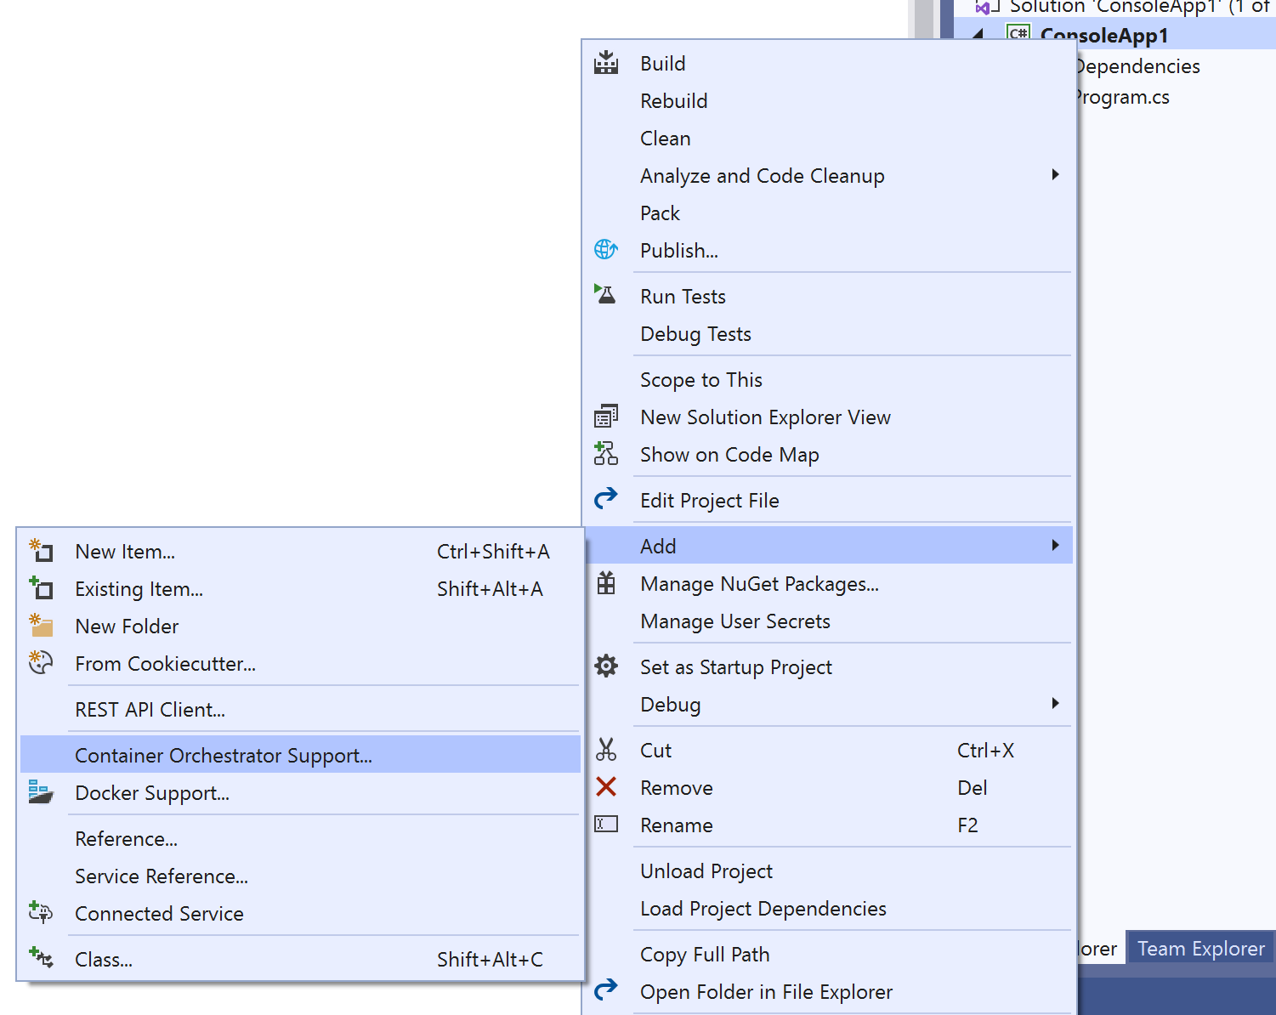
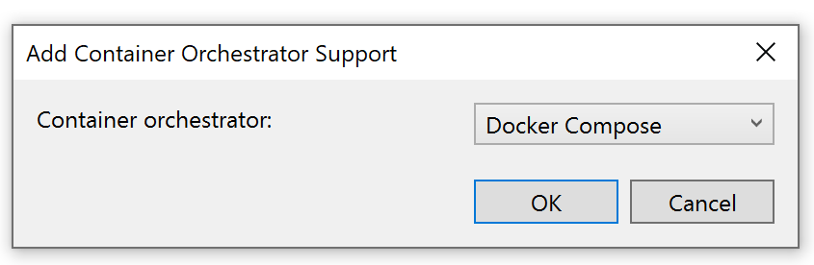
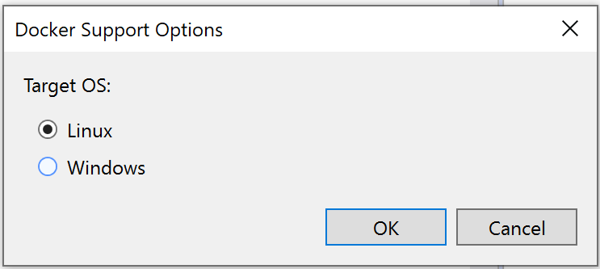
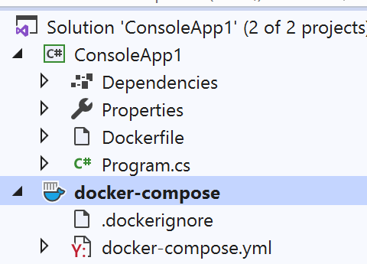
Create .NET App in container (II)
static void Main(string[] args)
{
int n = 100;
while (--n > 0)
{
Console.WriteLine("Hello World!");
Thread.Sleep(1000);
}
}

Slide 12
Dockerfile of .NET Core Application
FROM mcr.microsoft.com/dotnet/core/runtime:3.0-buster-slim AS base
WORKDIR /app
FROM mcr.microsoft.com/dotnet/core/sdk:3.0-buster AS build
WORKDIR /src
COPY ["DockerConsole.csproj", ""]
RUN dotnet restore "./DockerConsole.csproj"
COPY . .
WORKDIR "/src/."
RUN dotnet build "DockerConsole.csproj" -c Release -o /app/build
FROM build AS publish
RUN dotnet publish "DockerConsole.csproj" -c Release -o /app/publish
FROM base AS final
WORKDIR /app
COPY --from=publish /app/publish .
ENTRYPOINT ["dotnet", "DockerConsole.dll"]

Slide 13
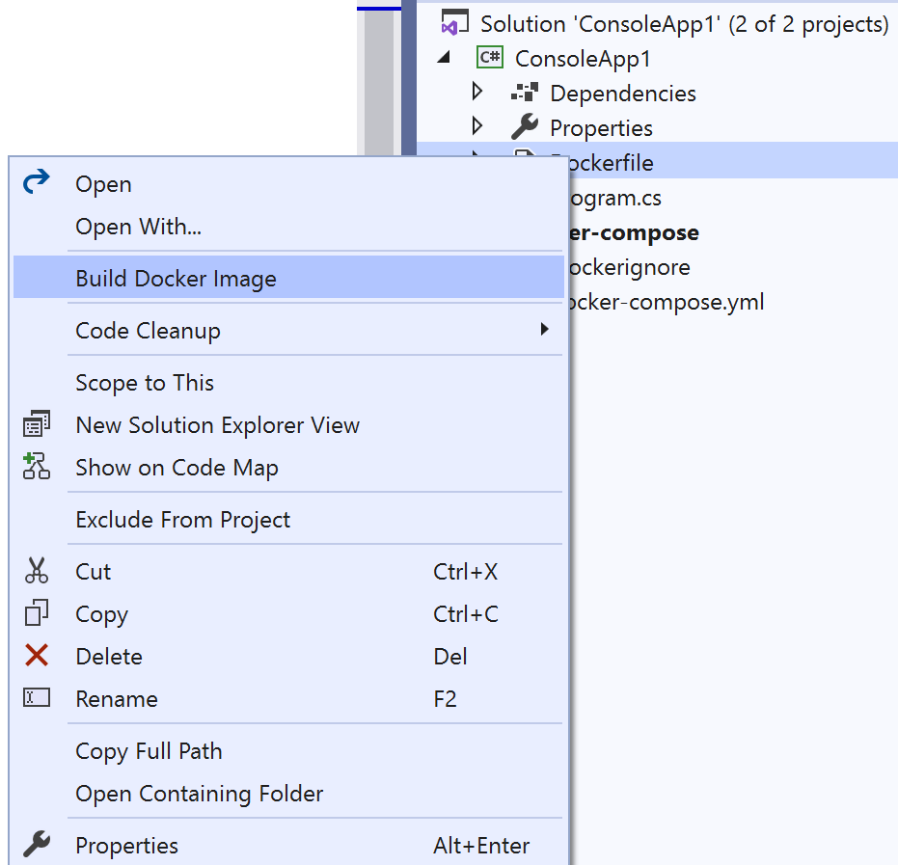
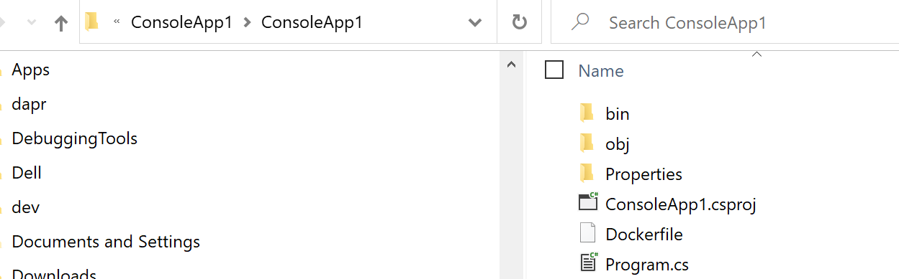
Build image
C:\temp\ConsoleApp1> docker build --rm -f “ConsoleApp1/dockerfile" -t dockerconsole:v1 .

Slide 14
Docker with proxy
docker build -f "dockerfile" --force-rm -t consoleapp1 "c:\..\repos\consoleapp1" --build-arg HTTP_PROXY=proxy.domain.com:8080 --build-arg HTTPS_PROXY=proxy.domain.com:8080
Append this to the build command

Slide 15
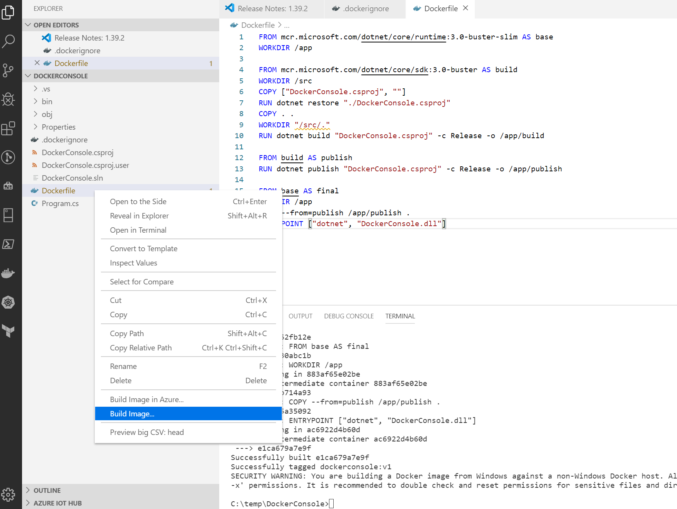
Build Image in VS Code

Slide 16
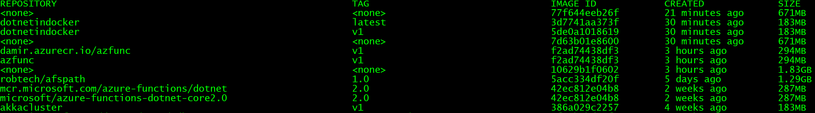
Docker Images
# List images
> docker images
# Remove dangling (<none>) images
> docker rmi $(docker images --quiet --filter "dangling=true")

Slide 17
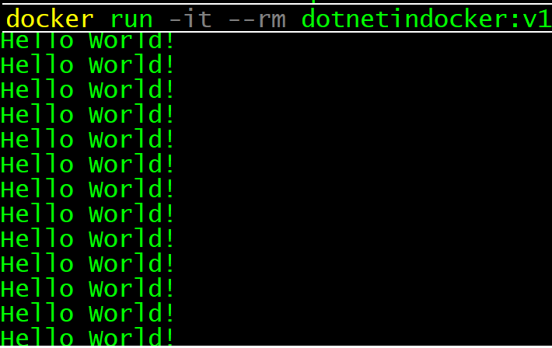
Run application
> docker run -it --rm YOURIMAGENAME:v1
>docker ps
>docker logs --follow 94615e1c7cc1

Slide 18
Create image from ASP.NET Core application
Follow same steps described on previous slides.
https://docs.microsoft.com/en-us/learn/paths/architect-modern-apps/

Slide 19
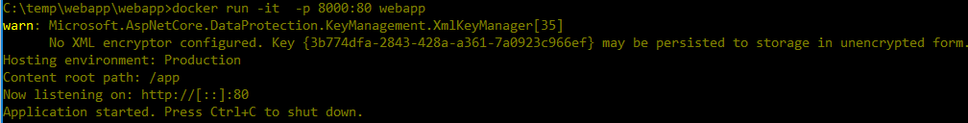
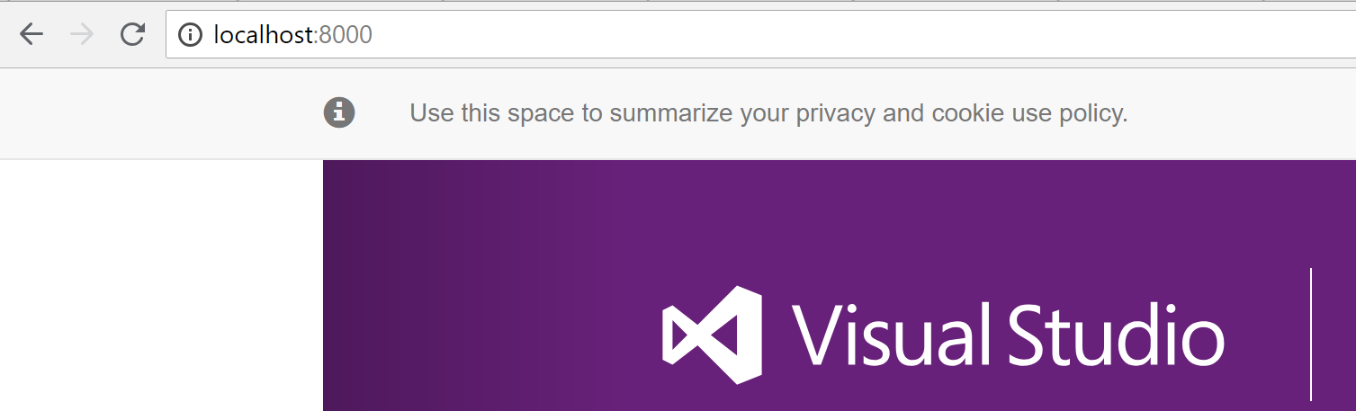
Run web application
Build image
# Build image
> docker build -t aspnetapp .
# Build image
> docker run -it --rm -p 8000:80 aspnetapp
Run container (application)
Navigate to application)
# See what is inside
docker run -it --rm --entrypoint /bin/bash 08b4553a412b

Slide 20
Azure Container Registry

Slide 21
Azure CLI Login
> az login
Start browser, navigate to this address and enterthe code.
Close browser and wait few seconds
>az account list
List all your subscriptions.
Just, as a test

Slide 22

Good to know
https://resources.azure.com/subscriptions/1b322303-6ba9-485e-99e8-ffc8d561ed4f
az group create --name RG-DELME --location germanywestcentral

Slide 23
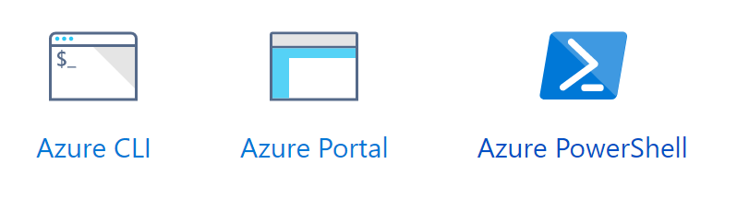
How to create container registry?
>az group create --name RG-REGISTRY --location westeurope
>az acr create --resource-group RG-REGISTRY --name somename --sku Basic
>az group delete --name RG-REGISTRY
https://docs.microsoft.com/en-us/azure/container-registry

Slide 24
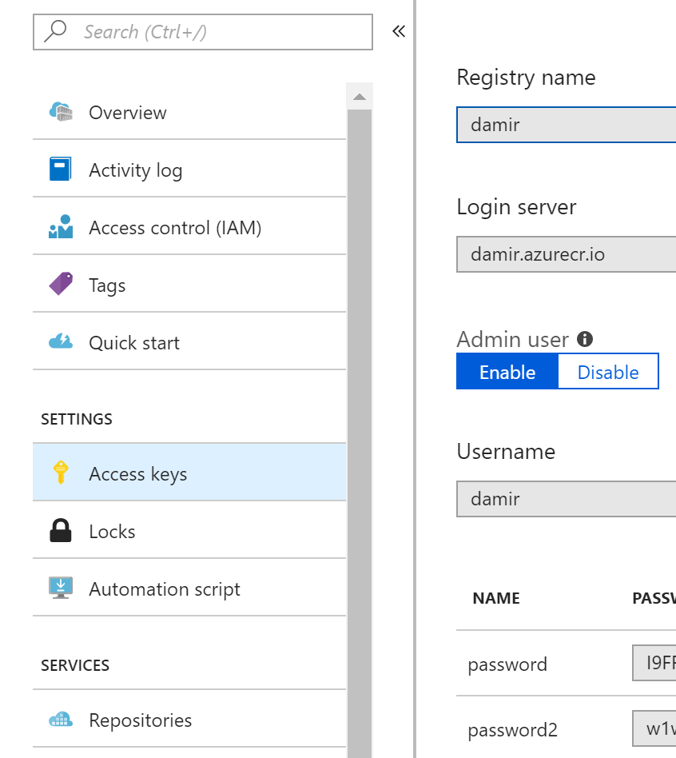
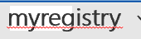
Enable Admin Access and login
With this we can access it from i.e.: command line
myregistry
myregistry
> docker login -u myregistry -p PWD myregistry.azurecr.io

Slide 25
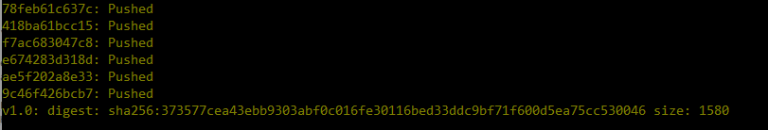
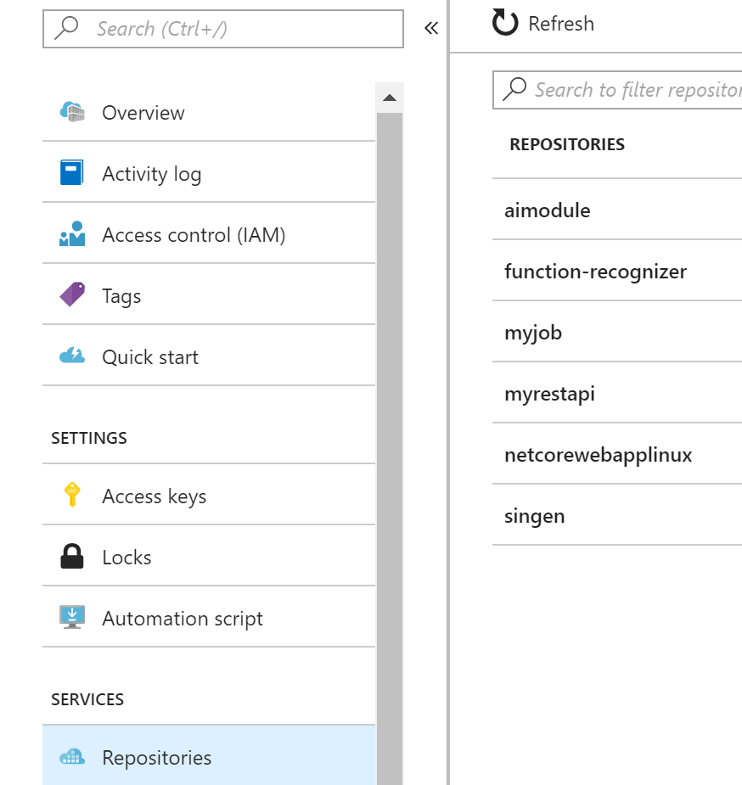
Publishing image to registry
Prepares image for push
> docker tag aspnetapp damir.azurecr.io/aspnetapp:v1.0
> Docker push damir.azurecr.io/aspnetapp:v1.0
Pushes (uploads) image to registry
After publish, repository can be viewed in portal

Slide 26
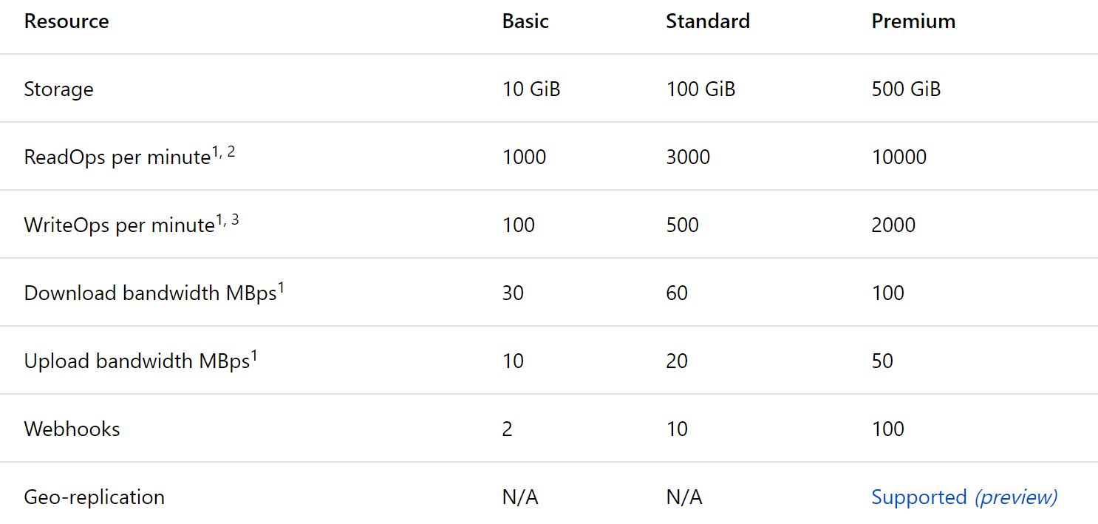
Features and SKUs

Slide 27
Pricing per day
5
20

Slide 28
Azure Container Instances

Slide 29



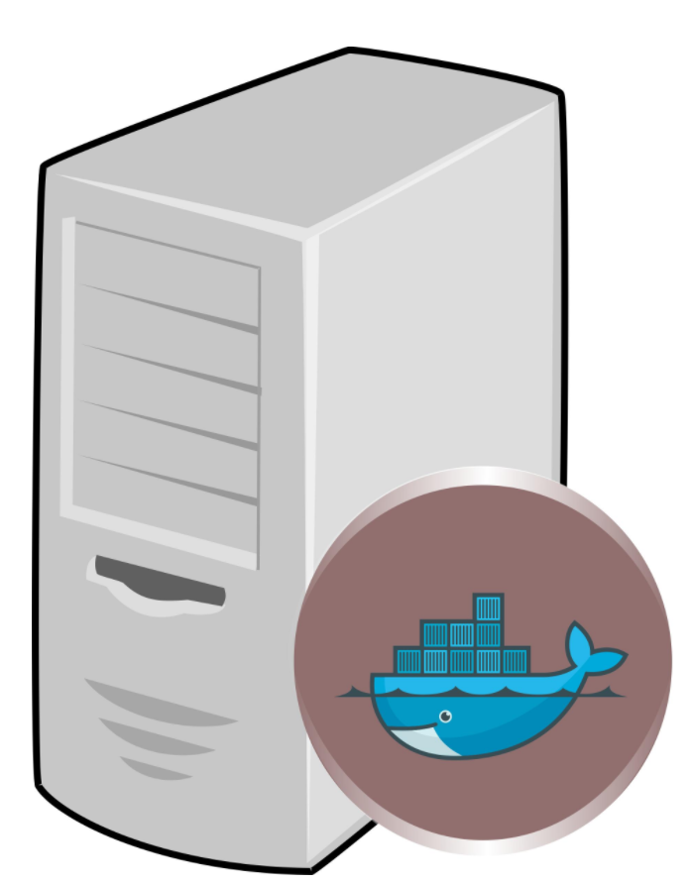

ACI is a host for docker containers
myreg.azurecr.io/myapp1
myreg.azurecr.io/myapp2
myreg.azurecr.io/myapp3
hub.docker.com/r/myreg/myapp1

Slide 30
How to create container instance?
az group create --name RG-ACI --location westeurope
az container create --resource-group RG-ACI
--name myservice1
--image damir.azurecr.io/mywebapi:latest
--ip-address public --ports 80
--os-type windows
--registry-login-server damir.azurecr.io
--registry-username username --registry-password ***
az container show --resource-group RG-ACI --name myservice1 --query "{FQDN:ipAddress.fqdn,ProvisioningState:provisioningState}" --out table
az container show --resource-group RG-ACI --name myservice1
Notes:
az group create --name RG-DEMO --location westeurope
az container create --resource-group RG-ACI --name myservice1 --image damir.azurecr.io/dockerconsole:v2 --ip-address public --ports 80 --os-type linux --registry-login-server damir.azurecr.io --registry-username damir --registry-password kkjOvM=J/sEyYTBW6TFltwuV5qXkVH70
az container create --resource-group RG-DEMO --name dockerdemo2 --image damir.azurecr.io/dockerconsole:v3 --ip-address public --ports 80 --os-type linux --registry-login-server damir.azurecr.io --registry-username damir --registry-password “kkjOvM=J/sEyYTBW6TFltwuV5qXkVH70" -e SbConnStr="Endpoint=sb://bastasample.servicebus.windows.net/;SharedAccessKeyName=demo;SharedAccessKey=MvwVbrrJdsMQyhO/0uwaB5mVbuXyvYa3WRNpalHi0LQ="

Slide 31
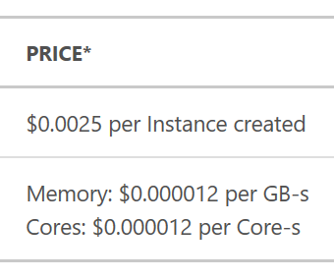
Azure container instances pricing
EXAMPLE: $11.85
You create a container instance with a 1 core, 2 GB configuration 50 times daily during a month (30 days).
The container duration of each instance is 2 minutes and 30 seconds.

Slide 32
Azure Container Service (AKS)

Slide 33
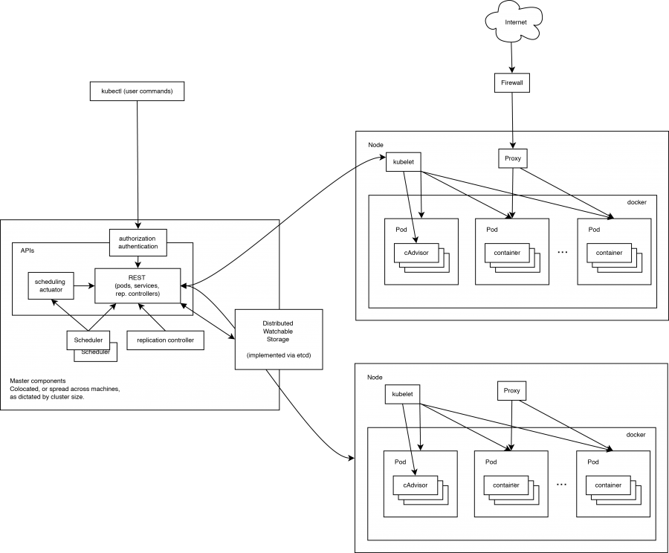
Kubernetes Cluster

Slide 34
K8 abbreviation
KUBERNETES => (K – eight characters – S) => K8S=>K8
WASGIBTES => (S – eight characters – a) => W7S=>W7

Slide 35
Kubernetes on Azure
Managed Kubernetes Cluster in Azure
You don’t deal with infrastructure
No maintenance of VM
No maintenance of Cluster
You pay for consumption

Slide 36
Cluster provisioning
az group create --name myResourceGroup --location westeurope
az aks create --resource-group myResourceGroup --name myAKSCluster --node-count 1 --generate-ssh-keys
Continue here: https://docs.microsoft.com/en-us/azure/aks/kubernetes-walkthrough
kubectl create -f mywebapi-deployment.yaml --validate=false
az aks browse -n myKubeCluster -g RG-KUBE
kubectl delete -f mywebapi-deployment.yaml
https://docs.microsoft.com/en-us/azure/aks/

Slide 37
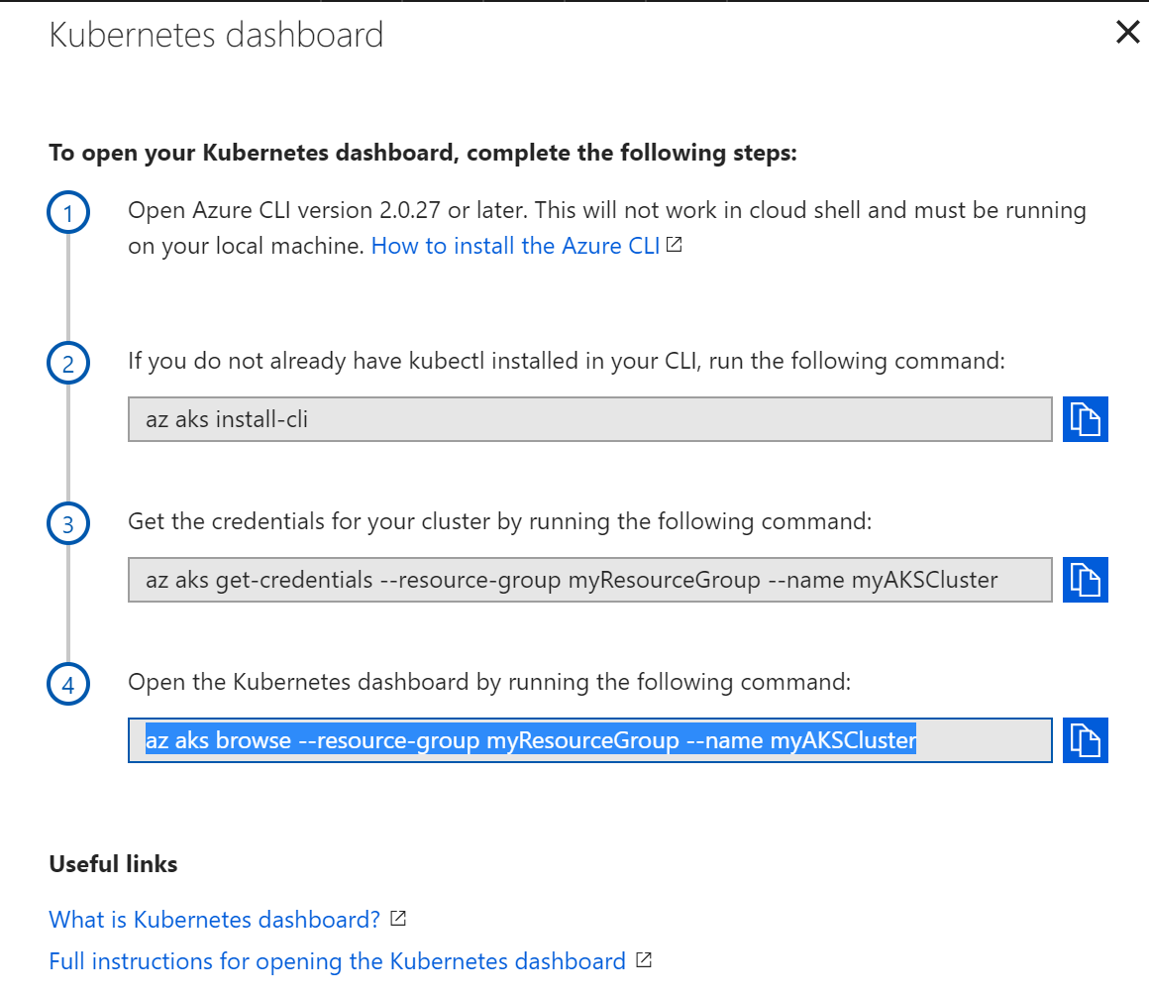
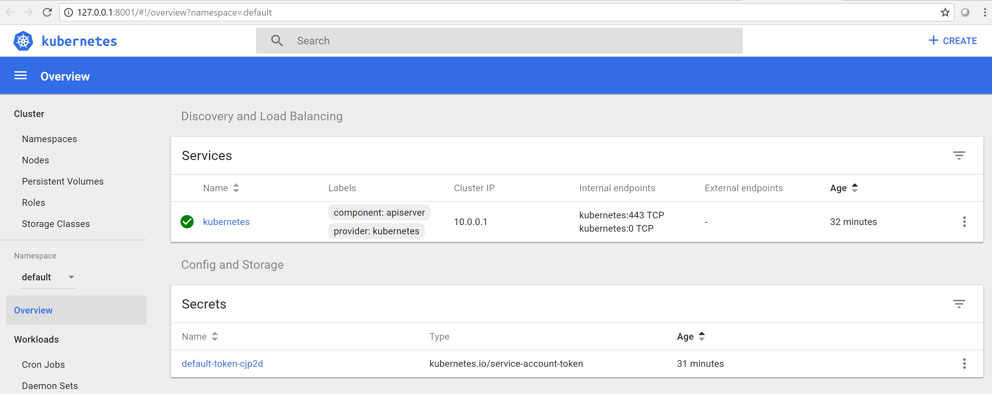
Kubernetes Dashboard

Slide 38
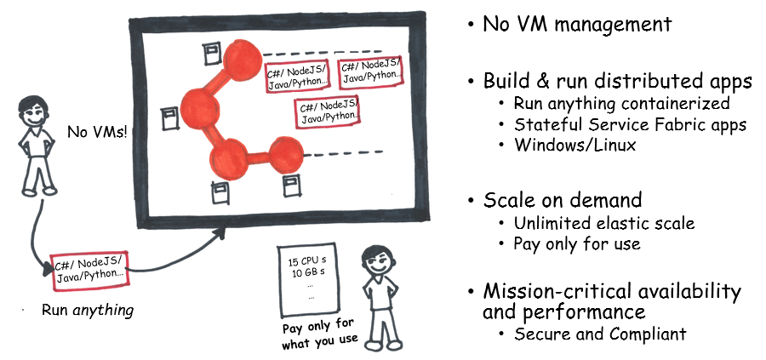
Service Fabric
Microsoft orchestrator is Service Fabric
Isolation on process level
Isolation with docker container

Slide 39
Container facts
Virtual machines
You can always do it, but it should not be your first choice
Containers
Still too much infrastructure
Helpful for lift-and-shift
Good approach for microservices, deployment and isolation
Supported on on-prem and in every cloud
Can help to avoid vendor-lock-in
App Service
Easier and more modern
Supported on Azure only
It can orchestrate docker containers
Serverless
Most simple, most modern and cheapest option
But it is a container for function and not for application
Not compatible across clouds

Slide 40
Recap
.NET Core runs on Windows and Linux in Docker
Azure Container Registry is a place where to store your containers
Azure Container Instances are easiest way to run containers
Azure Container Service (AKS) is fully managed Kubernetes
Service Fabric is MS orchestrator.
AppService supports docker too.
There are better ways to deploy applications, but containers seems to be most flexible choice at the moment

Slide 41
Why this all might be helpful?
Container
The most common approach to run the application
On-Prem and in every cloud.

Slide 42
Don’t forget
Lift-and-Shift
Same application can run on-prem and in every cloud.To avoid lock-down to vendor.
Vendor Lock-In
You can change cloud or combine clouds
But
Containers are popular, but not necessarily most innovative and efficient way to build software

Slide 43
Intro to Containers for exam: Architect Modern Apps
https://docs.microsoft.com/en-us/learn/paths/architect-modern-apps/

Slide 44
Thank_You ☺
T7☺
https://damirdobric.me

Slide 45
Thank You

